Slide 1



AI PERSONAS
Enrico Chen - s337750
Van Thanh Nguyen - s336748
Xiaoning Ma - s337332

Slide 2

Table of Contents
Introduction
Design
Management
Value Proposition
Project Goal
Stakeholder Map
User Personas
User Stories
Use Cases
User Requirements
Functional Diagram
System Architecture
Risks Analysis
WBS
Gantt Chart

Slide 3
Project Value Proposition
For business units struggling in evaluating marketing performances, customer understanding, models and ideas testing, our software allows interacting with data-driven AI Personas representing the different market segments

Slide 4

Sustainable Development Goals
Our project is aligned with the SDG 9 - Industry, Innovation and Infrastructure. By using advanced AI improve company’s efficiency and effectiveness.

Slide 5
Project Goal
The goal is to develop a software application where employees can interact dynamically with AI Personas representing different market segments to:
Identify weak ideas at an earlier phase by saving time and resources
Enable focused market strategies
Scale winning concepts efficiently and effectively

Slide 6
Design - Stakeholder Map
EXTERNAL
INDIRECT
Media & Press
DIRECT
Other Employees of the Company
Data Science (Development) Team
Coffee Suppliers
Consumers Insight Team
Marketing Team
Final Customers
Product Team
Enterprise Governance & Compliance Officers
Shareholders
Academic Partners

Slide 7

Design - Use Cases
Chat with a specific AI Persona
《extend》
AI Personas Configuration
《extend》
Marketing Team
Generate/Export Report
Access AI Personas’ reasoning
Access to AI Personas logs
Product Team
Access RAG system
Customer Insight Team
Manage Persona Models
Validate Persona Quality
Data Science Team

Slide 8




Design - User Personas
Marco Rossi
Giovanna Gallo
Luca Verdi
Giulia Cerullo
Description: 40, Consumers Insight Department employee
Tasks and Goals: consumers’ needs and behaviours identification to enhance company’s strategic decisions
Pain points: high time demand for data collection and analysis
Description: 35, Product Department employee
Tasks and Goals: management of new products development meeting consumers’ needs
Pain points: difficulty in effectively meeting needs, costly pre-launch products testing
Description: 30, Marketing Department employee
Tasks and Goals: planning of efficient and effective marketing campaigns, performance analysis
Pain points: advertisement campaigns uncertainty, costly testing
Description: 37, Data Scientist
Tasks and Goals: data preparation pipeline, market trends analysis, AI-driven decision support
Pain points: limited data availability, inefficient model testing on real consumers
Notes:
ask about should remove education of personas

Slide 9
Design - User Personas
Marco Rossi
Giovanna Gallo
Luca Verdi
Giulia Cerullo
Description: 40, Consumers Insight Department employee
Tasks and Goals: consumers’ needs and behaviours identification to enhance company’s strategic decisions
Pain points: high time demand for data collection and analysis
Description: 35, Product Department employee
Tasks and Goals: management of new products development meeting consumers’ needs
Pain points: difficulty in effectively meeting needs, costly pre-launch products testing
Description: 30, Marketing Department employee
Tasks and Goals: planning of efficient and effective marketing campaigns, performance analysis
Pain points: advertisement campaigns uncertainty, costly testing
Description: 37, Data Scientist
Tasks and Goals: data preparation pipeline, market trends analysis, AI-driven decision support
Pain points: limited data availability, inefficient model testing on real consumers
Notes:
ask about should remove education of personas

Slide 10
Design - User Personas
Marco Rossi
Giovanna Gallo
Luca Verdi
Giulia Cerullo
Description: 40, Consumers Insight Department employee
Tasks and Goals: consumers’ needs and behaviours identification to enhance company’s strategic decisions
Pain points: high time demand for data collection and analysis
Description: 35, Product Department employee
Tasks and Goals: management of new products development meeting consumers’ needs
Pain points: difficulty in effectively meeting needs, costly pre-launch products testing
Description: 30, Marketing Department employee
Tasks and Goals: planning of efficient and effective marketing campaigns, performance analysis
Pain points: advertisement campaigns uncertainty, costly testing
Description: 37, Data Scientist
Tasks and Goals: data preparation pipeline, market trends analysis, AI-driven decision support
Pain points: limited data availability, inefficient model testing on real consumers
Notes:
ask about should remove education of personas

Slide 11
Design - User Personas
Marco Rossi
Giovanna Gallo
Luca Verdi
Giulia Cerullo
Description: 40, Consumers Insight Department employee
Tasks and Goals: consumers’ needs and behaviours identification to enhance company’s strategic decisions
Pain points: high time demand for data collection and analysis
Description: 35, Product Department employee
Tasks and Goals: management of new products development meeting consumers’ needs
Pain points: difficulty in effectively meeting needs, costly pre-launch products testing
Description: 30, Marketing Department employee
Tasks and Goals: planning of efficient and effective marketing campaigns, performance analysis
Pain points: advertisement campaigns uncertainty, costly testing
Description: 37, Data Scientist
Tasks and Goals: data preparation pipeline, market trends analysis, AI-driven decision support
Pain points: limited data availability, inefficient model testing on real consumers
Notes:
ask about should remove education of personas

Slide 12
Design - User Stories
Marco Rossi
Giovanna Gallo
Luca Verdi
Giulia Cerullo
As a consumers insight department employee, I want a tool that can be used to facilitate the analysis of consumers’ needs and behaviours so that I can accelerate product launches
As a product department employee, I want a feedback system that can provide immediate insights so that I can launch a winning product more easily
As a marketing department employee, I want a tool that can be used to assess and compare different marketing strategies so that I can launch efficient and effective marketing campaigns to scale product sales
As a data scientist, I want a new source of data and an environment to test models so that I can have larger training dataset and I can test my models before deployment
(*) An example of user journey is in the Appendix

Slide 13
Design - User Stories
Marco Rossi
Giovanna Gallo
Luca Verdi
Giulia Cerullo
As a consumers insight department employee, I want a tool that can be used to facilitate the analysis of consumers’ needs and behaviours so that I can accelerate product launches
As a product department employee, I want a feedback system that can provide immediate insights so that I can launch a winning product more easily
As a marketing department employee, I want a tool that can be used to assess and compare different marketing strategies so that I can launch efficient and effective marketing campaigns to scale product sales
As a data scientist, I want a new source of data and an environment to test models so that I can have larger training dataset and I can test my models before deployment

Slide 14
Design - User Stories
Marco Rossi
Giovanna Gallo
Luca Verdi
Giulia Cerullo
As a consumers insight department employee, I want a tool that can be used to facilitate the analysis of consumers’ needs and behaviours so that I can accelerate product launches
As a product department employee, I want a feedback system that can provide immediate insights so that I can launch a winning product more easily
As a marketing department employee, I want a tool that can be used to assess and compare different marketing strategies so that I can launch efficient and effective marketing campaigns to scale product sales
As a data scientist, I want a new source of data and an environment to test models so that I can have larger training dataset and I can test my models before deployment

Slide 15
Design - User Stories
Marco Rossi
Giovanna Gallo
Luca Verdi
Giulia Cerullo
As a consumers insight department employee, I want a tool that can be used to facilitate the analysis of consumers’ needs and behaviours so that I can accelerate product launches
As a product department employee, I want a feedback system that can provide immediate insights so that I can launch a winning product more easily
As a marketing department employee, I want a tool that can be used to assess and compare different marketing strategies so that I can launch efficient and effective marketing campaigns to scale product sales
As a data scientist, I want a new source of data and an environment to test models so that I can have larger training dataset and I can test my models before deployment

Slide 16
Design - Functional Requirements
Must have | Configure AI Personas Enable users to interact with created Personas Cite the source of each answer Access RAG systems (such as vector databases)
Should have | Display chain-of-thought reasoning Generate and export reports Store all AI Persona logs for future processing Validate AI Persona quality
Could have | Enable log exporting and importing Authenticate users with differentiated access levels. Include SOTA explainability techniques
Won’t have | Customize the chat interface, including frontend layout, fonts, or styling options.

Slide 17
Design Non-Functional Requirements
Must have | Avoid hallucinations and remain consistent with segment definitions User-friendly and easy to use Operate in English Ensure data security Compliant with GDPR, AI Act and other relevant laws.
Should have | Support multiple users to work on multiple AI personas
Could have | Deliver real-time feedback
Won’t have | Large-scale concurrent request support.

Slide 18
Design - System Architecture Overview
UI
FE
Application Layer
Persona Configuration
Ingestion service
Q&A service
Report service
Auth
Communication Layer
RPC server
Cache
Event Broker/ Message Queue
Core Layer
Monitoring and Evaluation
Orchestrator
Prompt Construction
AI Persona Router
Evaluation
Metric & Alerting
Input Handler
RAG
Persona registry
Data Storage
Business logic DB
Object storage(S3)
MCP Server
Memory
Explanation
Vector DB
Search engine
(*) More details in the Appendix

Slide 19
Design - Functional Diagram
2.1
Text
2.2
PDF
2.
Input Handler
2.3.
Image
1.Query image/pdf
Orchestrator
1.1.
3.
RAG
4.1
4.
4.2
Websearch
MCP server
Data Services
4.3
5.
Explanation
APIs
4.4
Other tools
6.
7.
Persona registry
Prompt construction
8.
Memory
9.
10.Output
AI Persona Router
Fine-tuned Persona model
(*) More details in the Appendix

Slide 20
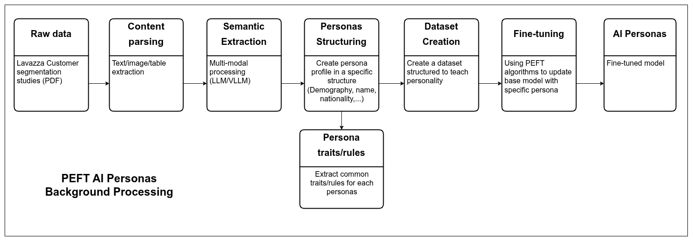
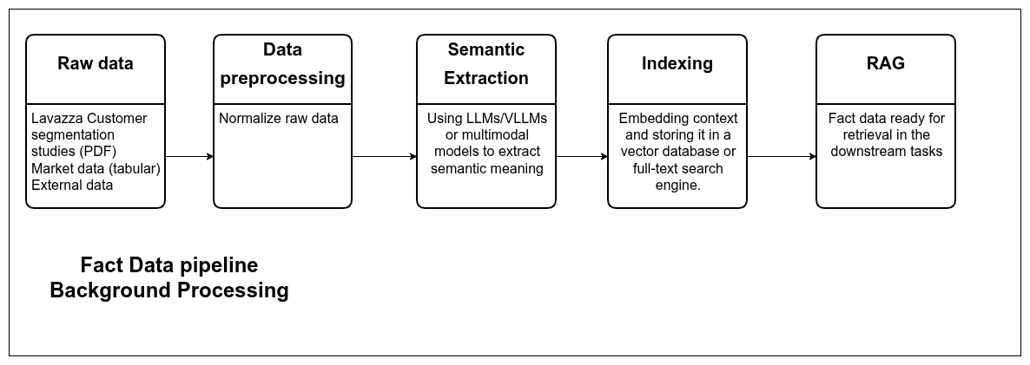
Design - Functional Diagram

Slide 21
Design - Risks Analysis
Technical Risks
Hallucinations and inaccurate responses: mitigate with RAG system
Insufficient critical thinking: mitigate with RAG and prompt engineering
Opacity: mitigate with RAG
Inconsistent or generic personality: mitigate by fine-tuning (in case of limited resource use PEFT, smaller models, RAG with few-shot prompting)
Performance evaluation difficulty

Slide 22
Design - Risks Analysis
Governance and Security Risks
Privacy and compliance with AI Act and GDPR
Proprietary data protection
System integration difficulty with existing systems and infrastructure
Notes:
Privacy and Complience: complice AI acts and GDPR.
Proprietary Data Protection: Safeguard Lavazza’s business data, maintaining strict confidentiality and preventing unauthorized access.
System Integration: Ensure smooth and secure alignment of AI solutions with Lavazza’s existing company systems and infrastructure.

Slide 23
Design - Risks Analysis
Data and Other Risks
Data integration difficulty
Data quality and bias
Over relying on AI Personas
Notes:
2. Data Risks
Data Integration Challenge: Heterogeneous (e.g., PDFs, tabular data, …)
Quality and Bias Issues: Data may be qualitative, incomplete, or imbalanced across segments, leading to biased persona representations and limited generalizability.

Slide 24
Manage
WB No | TASK TITLE | OWNER | COLLABORATORS | DEADLINE | PW
1 | Project Conception and Initiation | Thanh | Others | 19/11/2025 | 3.00
2 | Design | Enrico | Others | 19/11/2025 | 7.50
3 | Management | XiaoNing | Others | 19/11/2025 | 1.00
4 | Data Foundation | Thanh | Others | 10/12/2025 | 6.00
5 | PEFT AI Persona | XiaoNing | Thanh | 10/12/2025 | 4.00
6 | Fact Data Ingestion | Enrico | Others | 10/12/2025 | 2.50
7 | Core Layer | Thanh | Others | 07/01/2026 | 8.50
8 | Application Layer | XiaoNing | Others | 07/01/2026 | 2.00
9 | UI | XiaoNing | Others | 07/01/2026 | 1.50
10 | Monitoring and Evaluation | Enrico | Others | 07/01/2026 | 2.00
11 | Deployment | Thanh | Others | 07/01/2026 | 2.00
12 | Testing | XiaoNing | Others | 07/01/2026 | 2.00
13 | Demo | Enrico | Others | 07/01/2026 | 1.00
14 | Communication | Enrico | Others | 14/01/2026 | 5.00

Slide 25
Thank You
Enrico Chen - s337750
Van Thanh Nguyen - s336748
Xiaoning Ma - s337332

Slide 26

Appendix

Slide 27
Design - User Journey of Marco Rossi
Awareness
Conversion
Advocacy
Marco Rossi explores the system’s capabilities, its traceability features, and configures an AI Persona.
Marco Rossi uses the persona for concept testing and receives realistic, critical feedback grounded in the persona’s established profile.
Marco Rossi extends its use across teams for workshops, ideation, and strategic discussions. The system becomes a trusted long-term insight partner.
Consideration
Retention
Marco Rossi chats with the AI Persona, explores its characteristics, and reviews transparent, source-linked answers to understand how it represents its assigned consumer segment.
As trust grows, the AI Persona becomes part of Marco Rossi’s regular concept-validation workflows, offering traceable and compliant evaluations.

Slide 28
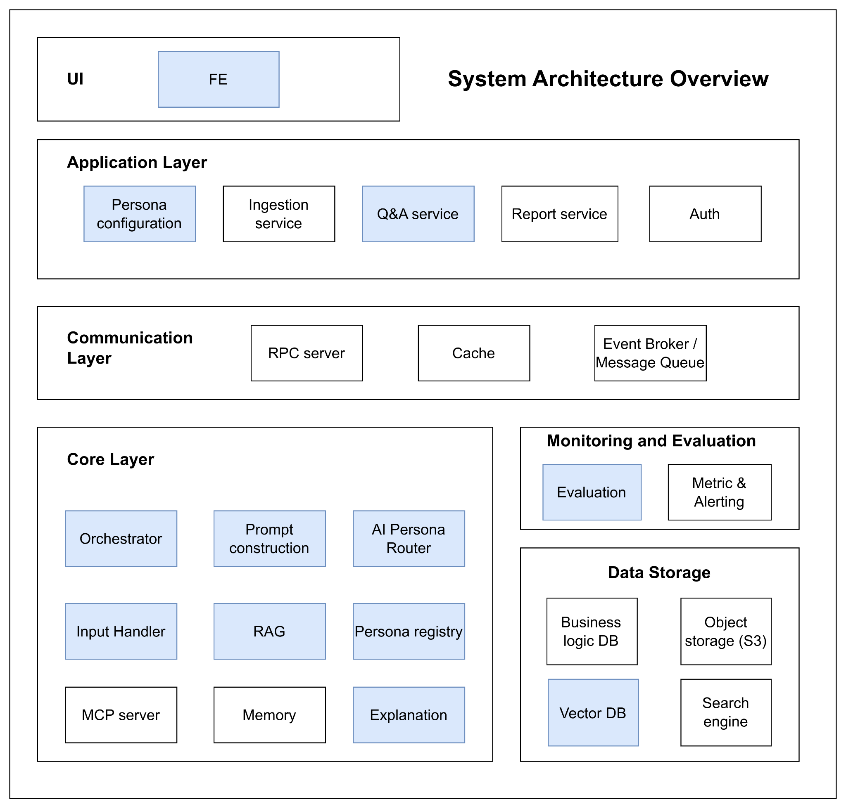
Design
1. User Interface (UI)
The user interface serves as the system’s entry point, built as a Frontend (FE) application. It enables users to interact seamlessly with the platform, submit queries, upload data, and view results or reports.
2. Application Layer
This layer contains the core application logic and manages all user-driven workflows.
Key components include:
Persona Configuration: Enables users to select or customize AI personas dynamically.
Ingestion Service: Handles ingestion of raw data such as PDFs or images and stores them in S3.
Report Service: Generates structured, formatted reports from processed and analyzed data.
Q&A Service: Manages interactive question-and-answer exchanges with the AI.
Auth Service: Provides authentication and authorization for users, ensuring secure access and operations.
3. Communication Layer
This layer facilitates efficient communication and coordination among microservices.
RPC Server: Enables direct service-to-service communication via Remote Procedure Calls.
Cache: A high-speed memory layer that stores frequently accessed data to optimize performance.
Event Broker / Message Queue (RabbitMQ or Kafka): Handles asynchronous communication and event-driven processing across services, ensuring reliability, scalability, and robust monitoring.

Slide 29
Design
4. Core Layer
The intelligence engine of the system—handles AI persona logic, LLM orchestration, and data-driven grounding.
Orchestrator: The central coordinator of the Core Layer. When a request arrives, the Orchestrator manages the entire generation process, directing which services to call.
Input Handler: Preprocesses and normalizes user inputs, including text extraction from PDFs and preparation of image data for AI analysis.
Prompt Construction: Dynamically builds structured prompts by combining user input, persona rules, and retrieved data.
AI Personas: Represents the fine-tuned Large Language Models (LLMs) tailored to embody distinct customer segment personalities.
RAG (Retrieval-Augmented Generation): Provides factual grounding by retrieving relevant information from the Vector DB, ensuring responses remain accurate.
Persona Registry: Stores the static attributes and behavioral definitions of each persona, guiding prompt construction and response tone.
Explanation: This module allows for an in-depth explanation of the thought process behind the reasoning model and the data used in the thinking process.
MCP Server (Model Context Protocol Server): Enriches LLM interactions with real-time contextual or external domain data.
Memory: It stores the recent history of the user's chat, allowing the persona to remember what was said earlier in the conversation and provide context-aware answers.

Slide 30
Design
5. Monitoring and Evaluation
A centralized observability layer that tracks performance, quality, and reliability across all services.
Evaluation Tools: Measure the accuracy and quality of AI responses and data processing outcomes.
Metrics & Alerting: Monitor key indicators such as latency, error rates, resource utilization, and token usage, triggering alerts for anomalies or system degradation.
6. Data Storage Layer
The persistence foundation of the system, designed for scalability, durability, and speed.
Business Logic Database: Stores structured data such as user profiles, authentication records, saved reports, and persona definitions.
Object Storage (S3): Manages large, unstructured data files (e.g., raw PDFs, images, and uploaded datasets).
Vector Database: Stores embeddings for persona-related documents, historical interactions, and reference materials — powering RAG retrieval and factual grounding.

Slide 31
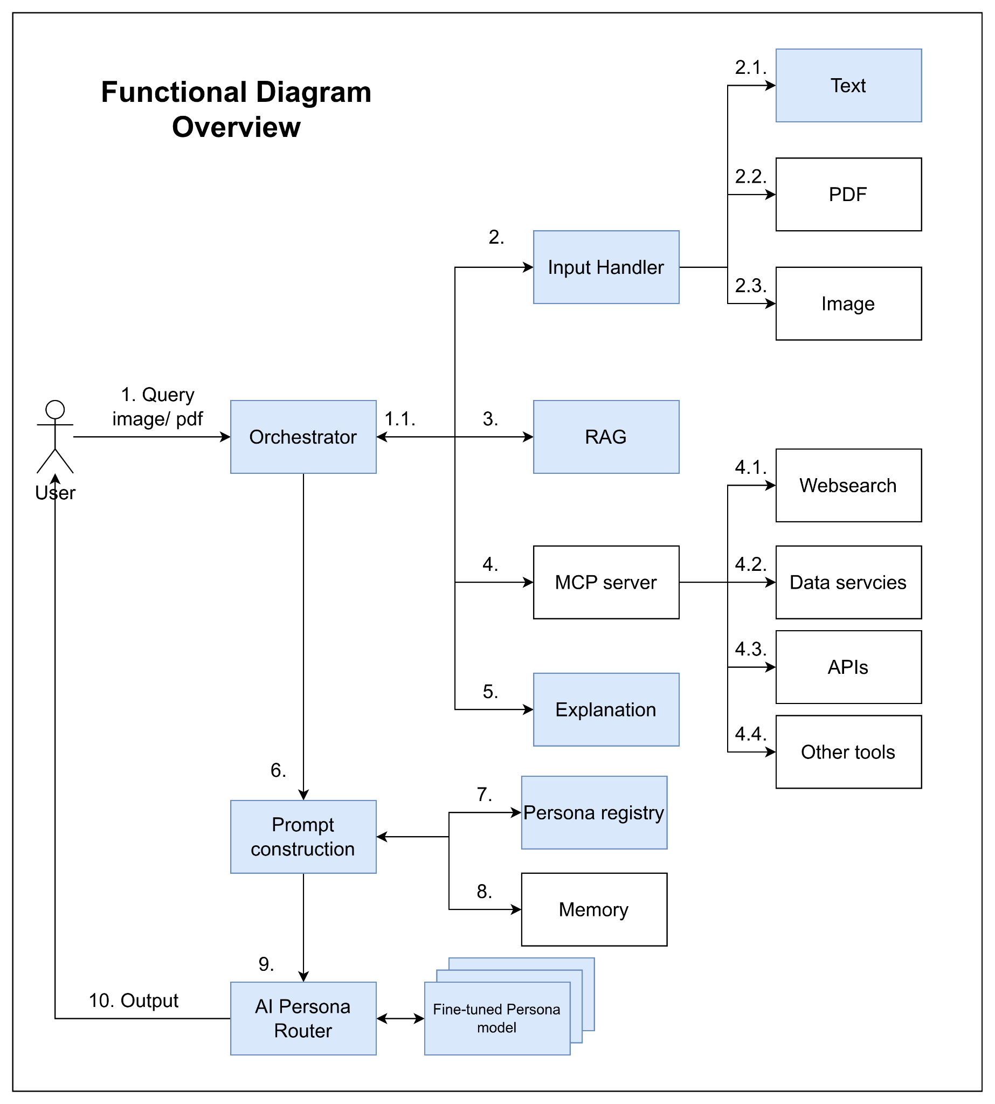
Design
1. User Query Submission: User sends a query with optional attached files (image, PDF, etc.) to the Orchestrator.
1.1 Orchestrator Analysis: The Orchestrator analyzes the query and attachments to decide which services should be used.
2. Input Preprocessing: Inputs are preprocessed before passing to the model.
2.1 Text Input: Normalize text to make it easier to handle in later steps.
2.2 PDF Input: Parse, process, and extract meaningful information from PDF files.
2.3 Image Input: Process images and extract valuable information.
3. Context Retrieval (RAG System): Use the query and relevant input information to retrieve context (e.g., market data) via a RAG system.
4. Tool Selection & MCP Server Requests
Decide which tools should be used to enrich the context.
Send requests to the MCP server to gather corresponding context.
4.1 Web Search: Extract updated information from the internet (trends, real-time data, missing internal data, etc.).
4.2 Database Query: Retrieve useful data from internal or external databases.
4.3 External APIs: Call APIs to obtain additional information.
4.4 Other Tools: Use calculators, simulators, weather data extractors, or other utilities to enrich context.
5. Explanation: The explanation module will explain in detail the thought process of the reasoning model and the data used for the thinking process.
6. Prompt Construction: The Orchestrator aggregates useful context and passes it to Prompt Construction.
7. Persona Selection
Apply the selected Persona profile, including: Demographics, Behavior Data, Transactional Data, …
8. Memory Integration
Extract useful information from chat history.
9. Persona Model Routing
Route to a fine-tuned Persona model.
Pass the enriched prompt and context.
10. Model Response
Generate a response with: Specific personality,Tone, Linguistic style of the Persona

